Slide 1
Run Predictor for Shakib Al Hasan Using Machine Learning Models
Fida Rahman

Slide 2
Project Description
Cricket is a very popular South-Asian sports called ‘Cricket.’ It’s a sport very similar to baseball. In cricket, the different categories of players are Bowlers, Batsmen and Fielders.
This project is about predicting the performance of a Batsman (how many runs he scores in match).
The number of runs, a batsman scores depend on few factors such as the grounds where the match is being played, the opposition, the type of bowlers the batsman faces, whether the batsman bats first or second (innings) and some other factors.
There are many formats in which this game is played in, and I have chosen the ODI format.
I will try to use different machine learning models with my own custom-made dataset, to predict the performance of a Bangladeshi player named ‘Shakib Al Hasan’ who is a Batsman.

Slide 3
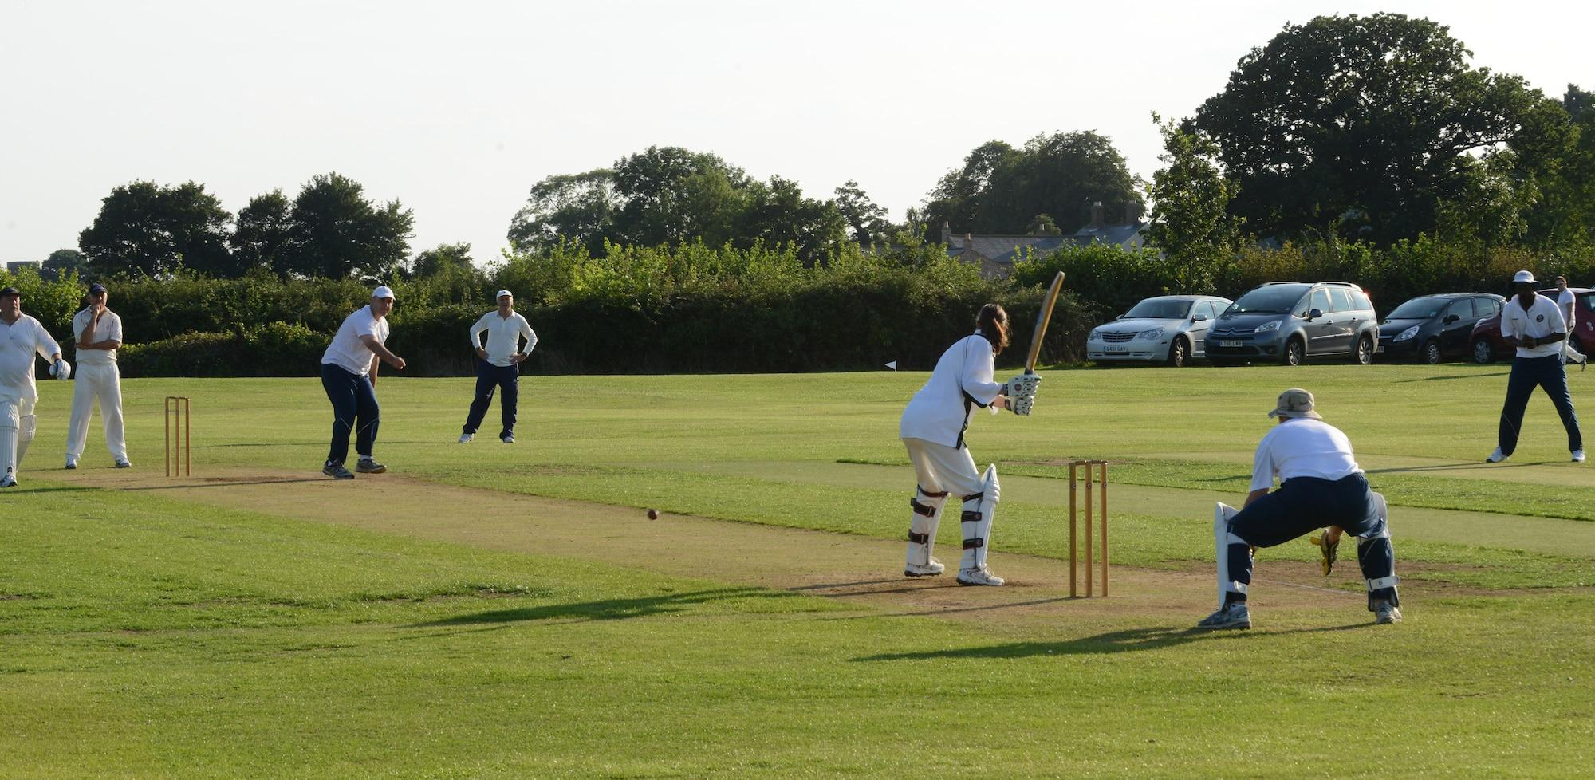
How the sport looks in real life

Slide 4
Dataset
As cricket is not a very popular sports worldwide, there was not any proper dataset that I could have used. Not many works have been done in the field of cricket using Artificial Intelligence.
Collecting data was a big part of this project as there were not enough ready-made datasets that I could have used. I took data from a popular cricket website named ‘ESPN CricInfo’ (https://www.espncricinfo.com/)
As this data was not sufficient to run my models and to predict the runs accurately, I had to go through the commentary of each of the matches from 2010-2022 to see what sort of bowlers the batsman faced, to improve my dataset.

Slide 5
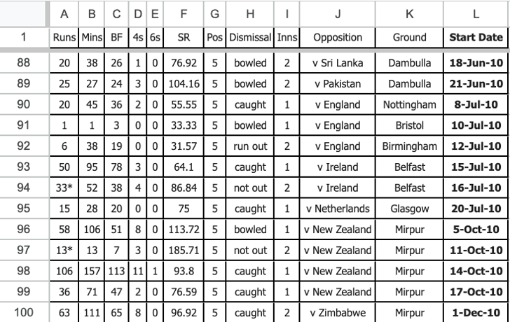

Slide 6
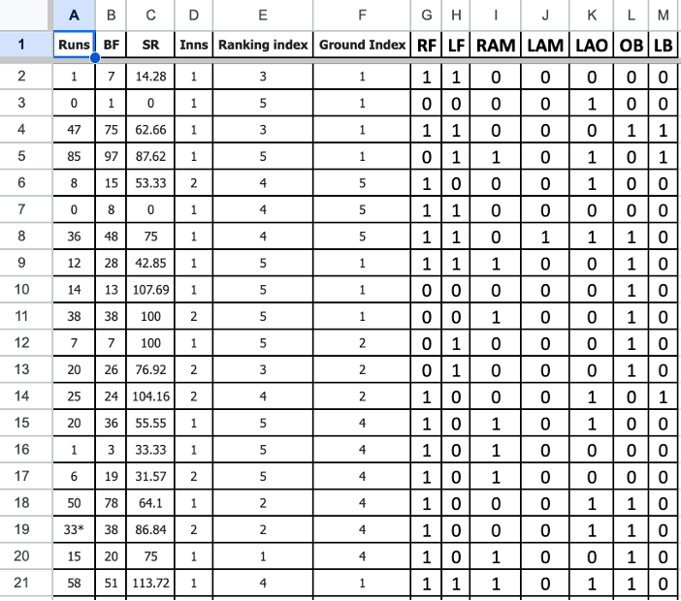

Slide 7
Dataset -Additions to improve the dataset
I have added 9 new extra columns to make the dataset better to predict the number of runs scored. The columns like RF, LF, RAM, LAM, LAO, OB and LB show the type of bowlers Shakib Al Hasan (Batsman) will face.
BF stands for the number of ‘Ball Faced’ to score runs.
SR stands for strike rate which means the rate at which the batsman scored.
Inns stands for innings, which means whether a batsman bats first(1) or second(2).

Slide 8
Dataset - Ranking Index
The ranking index was done to show how strong the opposition team is. The ranking index was done by taking the ranking of the different teams into consideration in the last 10-12 years. The ranking index 1 means, the opposition was the easiest and 5 meaning the toughest opposition to face.

Slide 9
Dataset - Ground Index
The ground index is also very similar. It shows the different types of ground where matches were played. As Shakib Al Hasan is a player from Bangladesh(bd), 1 being the easy ground and 5 is Australia(Aus) being the toughest ground to score runs.

Slide 10
Dataset - HeatMap
A heatmap was done to show the correlation of the dataset. It shows strong correlation for BF and SR with respect to runs scored. In some cases, there was negative correlation which might be due to the shortage of data we have.

Slide 11
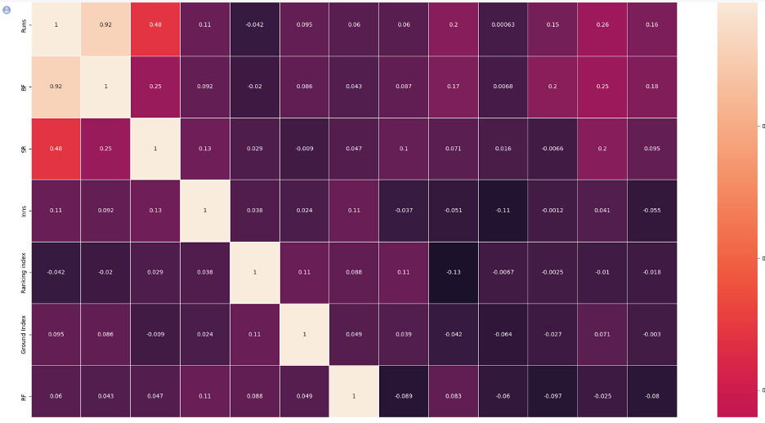

Slide 12
Dataset
In total we had data from 141 matches played in the last 12 years. Our dependent variable was ‘runs’ that we tried to predict and the independent variables were BF, SR, Inns, Ranking Index, Ground Index, RF, LF, RAM, LAM, LAO, OB and LB. These were split into train and test datasets.

Slide 13
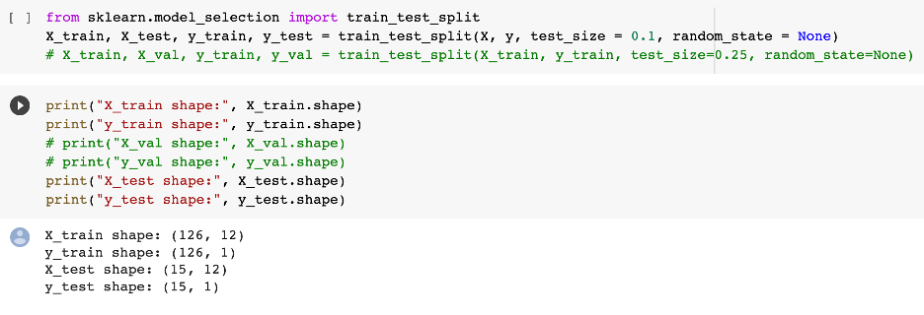

Slide 14
Dataset - Normalizing
The data were normalized using standard scaling. We normalize values to bring them into a common scale, making it easier to compare and analyze data. Normalization also helps to reduce the impact of outliers and improve the accuracy and stability of statistical models.

Slide 15
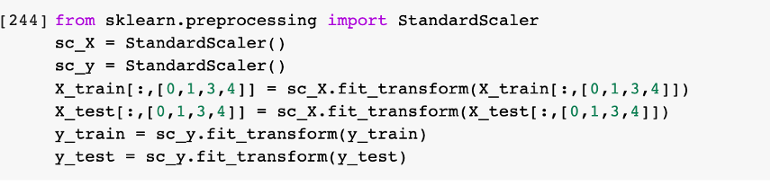

Slide 16
Models - Multiple Linear Regression
A technique that uses two or more independent variables to predict the outcome of a dependent variable.

Slide 17
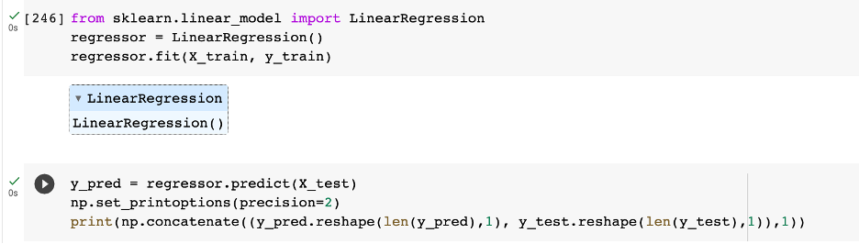

Slide 18
Models - Decision Tree
A supervised learning algorithm, which is utilized for both classification and regression tasks. It has a hierarchical, tree structure, which consists of a root node, branches, internal nodes, and leaf nodes. In supervised learning, the training data provided to the machines work as the supervisor that teaches the machines to predict the output correctly. Supervised machine learning is generally used to classify data or make predictions.

Slide 19
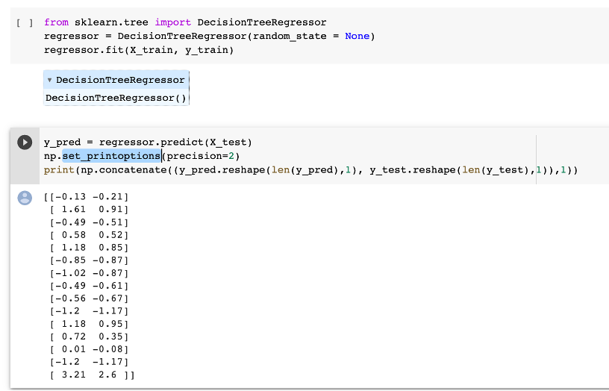

Slide 20
Models - Random Forest
Random forest is a commonly used machine learning algorithm which combines the output of multiple decision trees to reach a single result. Its ease of use and makes it handles both classification and regression problems. In our case it is a regression problem as are trying to predict a value.

Slide 21
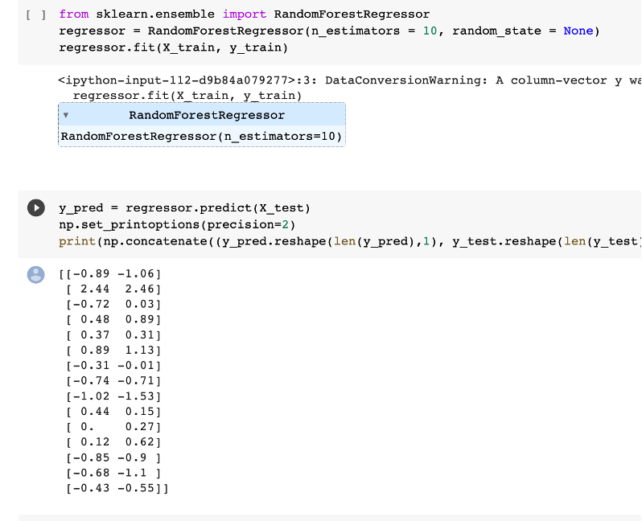

Slide 22
R2 or R Squared Score
R2 score is a very important metric that is used to evaluate the performance of a regression-based machine learning model. It is a statistical measure of how well the regression predictions approximate the real data points. In general, the higher the R-squared value, the better the model fits the data.

Slide 23
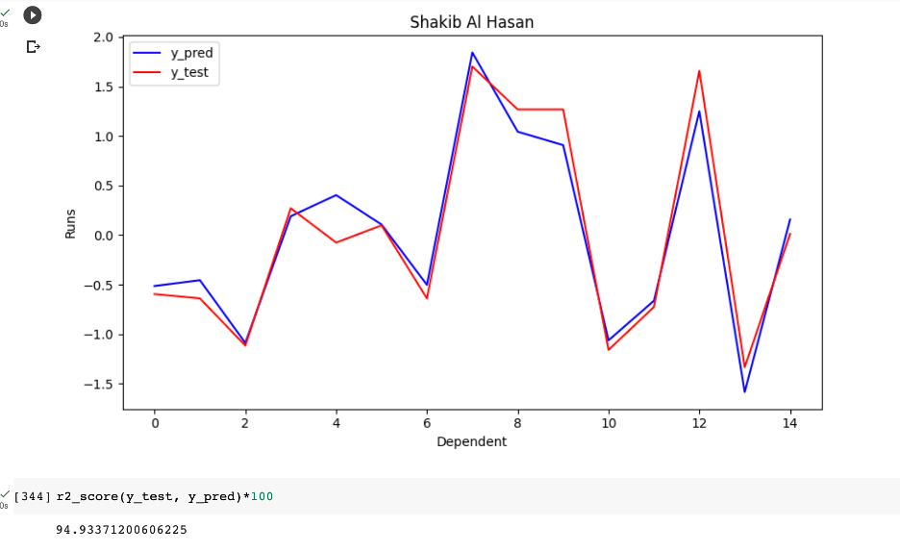
R2 score for MLR Model

Slide 24
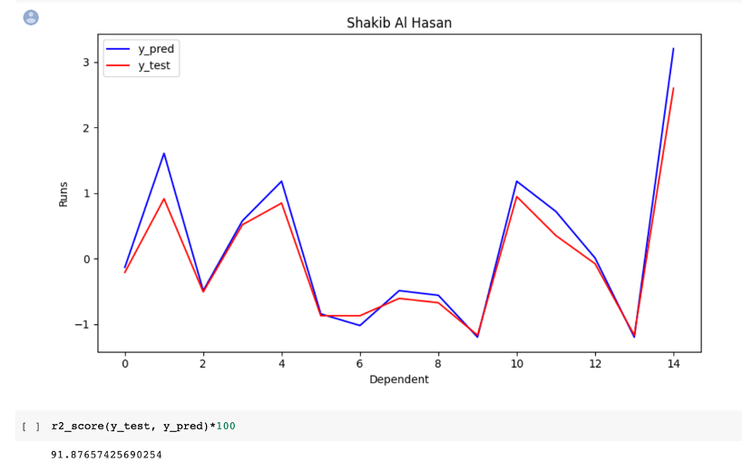
R2 score for DT Model

Slide 25
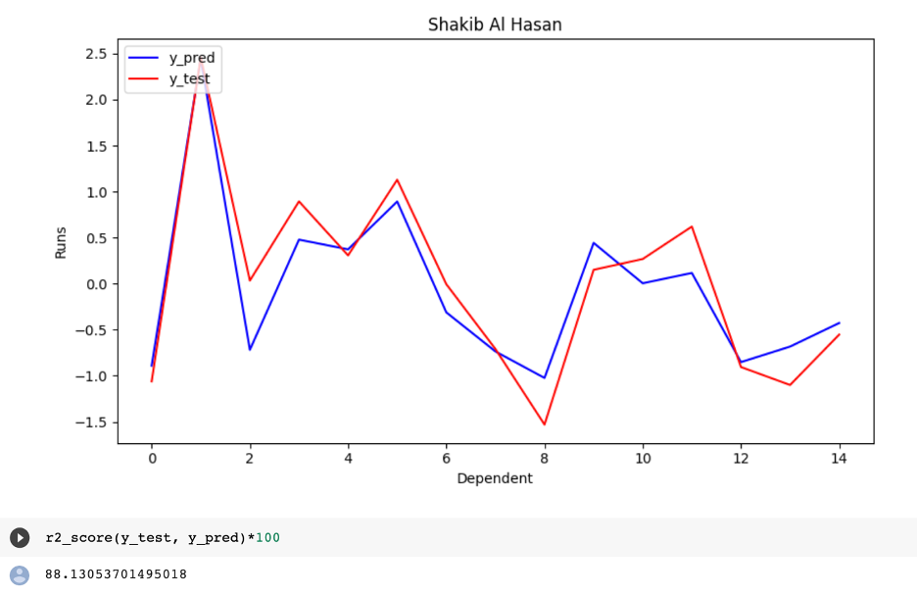
R2 score for RF Model

Slide 26
Best Model
Although all the 3 models performed very similar to each other, MLR model outperformed all the other models. With 94% as the r2 score.

Slide 27
Now, let’s look at the program demo!

